Slide 1
Digital HHZ Abderraouf Gharbi, Julia Hain, Valeria Kinitzki, Peter Kühfuß, Manh Phi Nguyen, Natascha Sigle GitHub Repository: https://github.com/Bariumm/HHZ_IoT
Modul Projekt 1, Prof. Decker, 06.10.2017

Slide 2
Agenda
Business Model
Project Management
Sensors
Overview
Hackathon
Outlook

Slide 3
Business Model

Slide 4
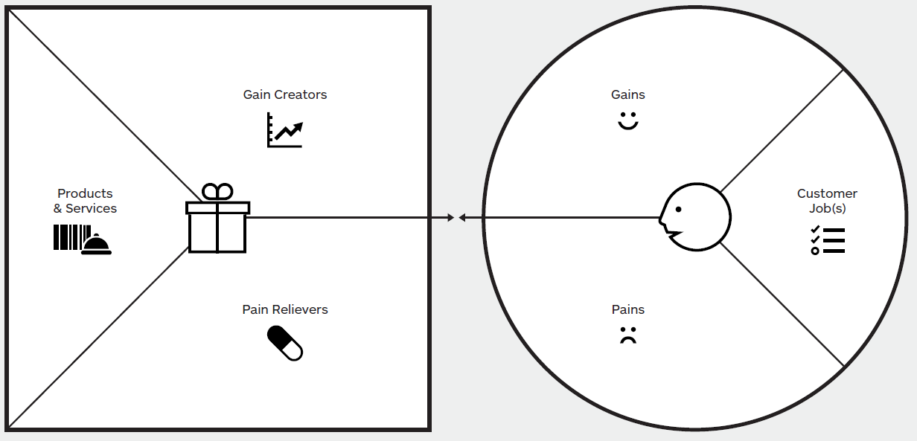
Value Proposition Canvas
Monitoring and remote control
Room monitoring
Automation
Remote control
Mood monitoring
Sensors
Actors
Computation
Studying
Lecturing
Mood monitoring
Notifications based on sensor data
Bad air quality
UI
API
Loss of concentration
Managing facilities
Providing desired information per use case (student, lecturer ...)

Slide 5
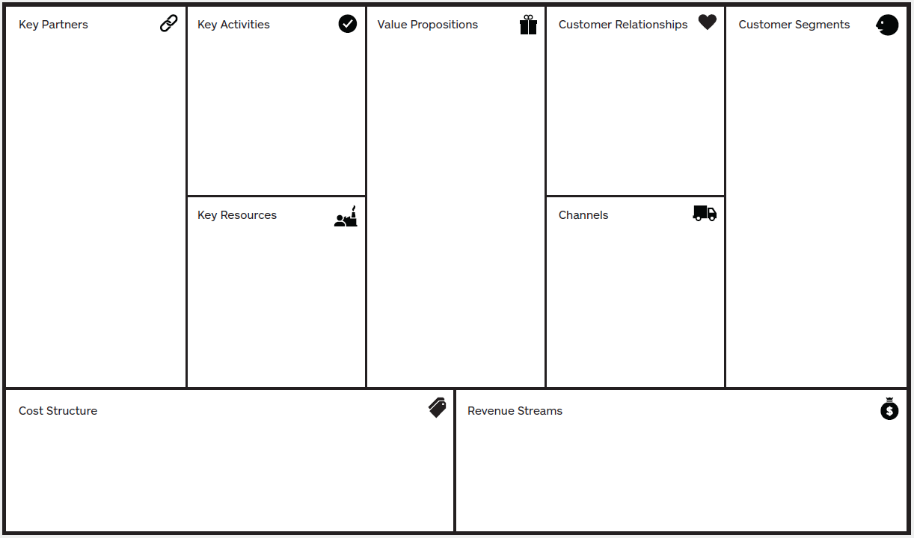
Business Model Canvas
Vendors of hardware
Open source communities
Collecting sensor data
Providing UIs and APIs
Maintaining infrastructure
Sensors
Actors
UI
API
Computation
Acquisition by study or contract
Raising awareness through digitalization
Lecturers
Students
Facility management
Visitors
IoT devices
Infrastructure (network, servers)
3rd party (web) services
Physical
Digital
Acquisition costs
Infrastructure

Slide 6
Vision
Services for different types of customer:
Notification service
Roominfo service
Student service
Lecture service

Slide 7
Project Management

Slide 8




Project Management Tools

Slide 9
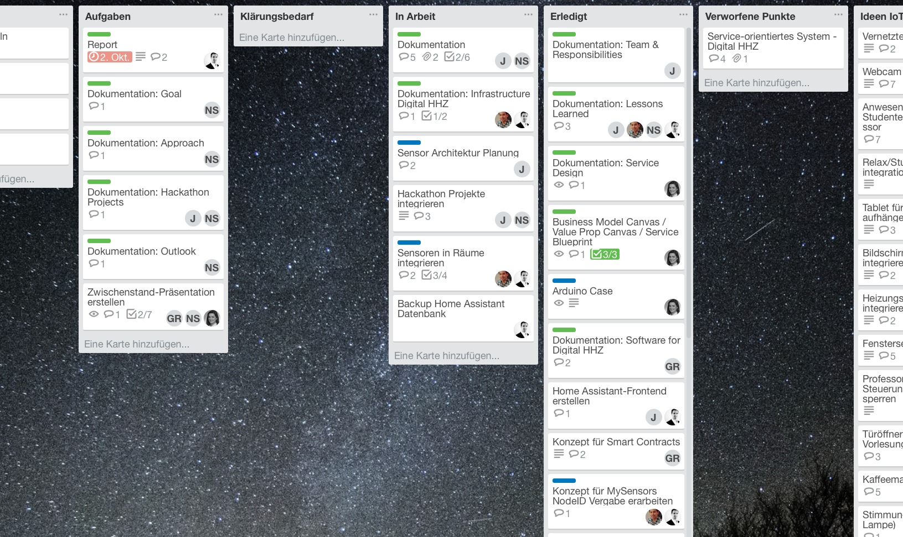
Trello

Slide 10
Sensors

Slide 11
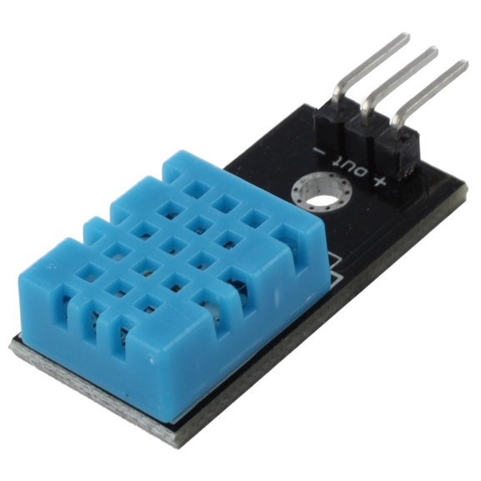
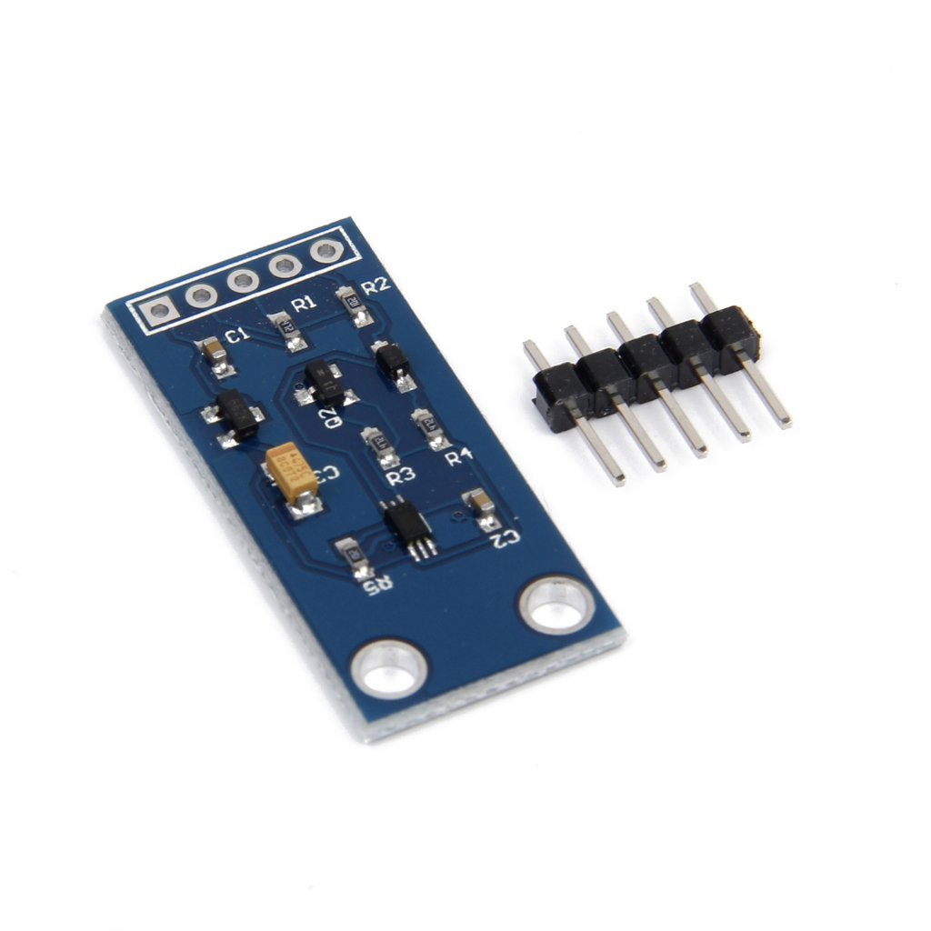
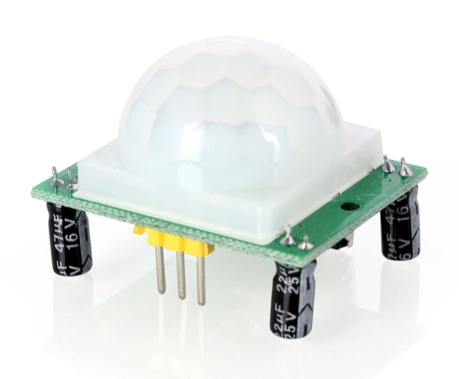
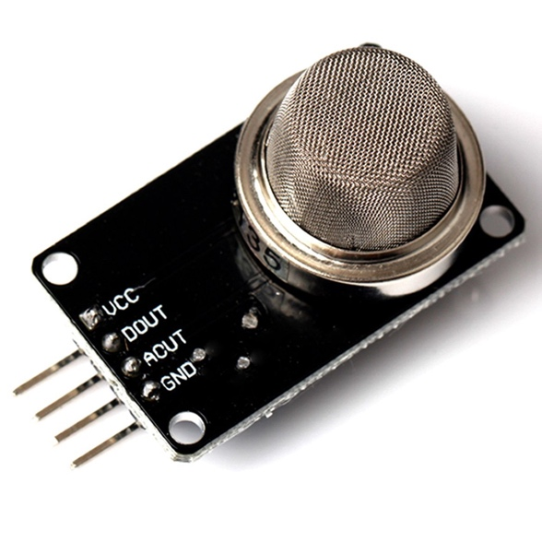
Sensors
Temperature DHT 11
Humidity DHT 11
Light BH 1750
Motion HC-SR501
Air quality REHAU air quality sensor
https://images-na.ssl-images-amazon.com/images/I/61Ru8GOWVSL._SL1100_.jpg
https://images-na.ssl-images-amazon.com/images/I/51ImjMAM0RL._SL1024_.jpg
https://images-na.ssl-images-amazon.com/images/I/618%2BQ00JWPL._SL1500_.jpg
https://images-na.ssl-images-amazon.com/images/I/71ydhfTurjL._SL1170_.jpg

Slide 12
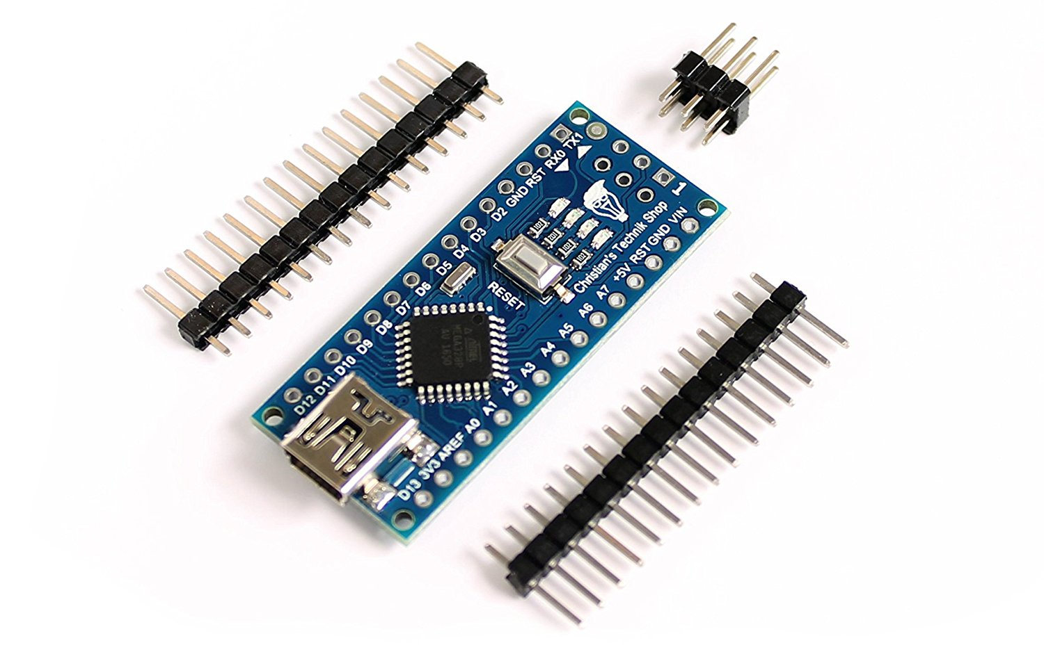
Additional Hardware
Arduino nano
Radio module
NodeMCU
Raspberry Pi 3
https://images-na.ssl-images-amazon.com/images/I/81o-NG5RNeL._SL1500_.jpg

Slide 13
Sensor Plan
EG 120: motion, humidity, temperature, light, air quality
EG 125: motion, humidity, temperature, light, air quality
EG 126: air quality

Slide 14
Sensor Cases 3D Prints – Humidity Sensor

Slide 15
Sensor Cases 3D Prints – Motion Sensor

Slide 16
Sensors Infrastructure

Slide 17
Cost Structure
Backend
One time cost for backend
Server to run the necessary applications
Room
Each room has the same sensors
Total cost of 76,40€ per room
Notes:
20,00€ WifiRouter
6,80€ Raspberry Zero
30,00€ Air Quality
3,80€ * 3 Arduino
3,80€ * 4 Funkmodul
2,10€ Temparatut/Luftfeuchtigkeit
1,60€ Bewegungsmelder
2,30€ Helligkeitssensor
6,00€ NodeMCU

Slide 18
Overview

Slide 19
Infrastructure

Slide 20





Technologies
Home Assistant
MQTT
MySensors
Docker
Telegram
SQLite
https://home-assistant.io/images/components/alexa/alexa-512x512.png
http://3u6cmn2fbv4r1slybd2uhm1e.wpengine.netdna-cdn.com/wp-content/uploads/2015/07/mqtt-logo-whitebg.png
https://upload.wikimedia.org/wikipedia/commons/thumb/4/42/MySensorsLogo.svg/1200px-MySensorsLogo.svg.png
https://telegram.org/img/t_logo.png
https://upload.wikimedia.org/wikipedia/commons/thumb/3/38/SQLite370.svg/1200px-SQLite370.svg.png

Slide 21
Hackathon

Slide 22
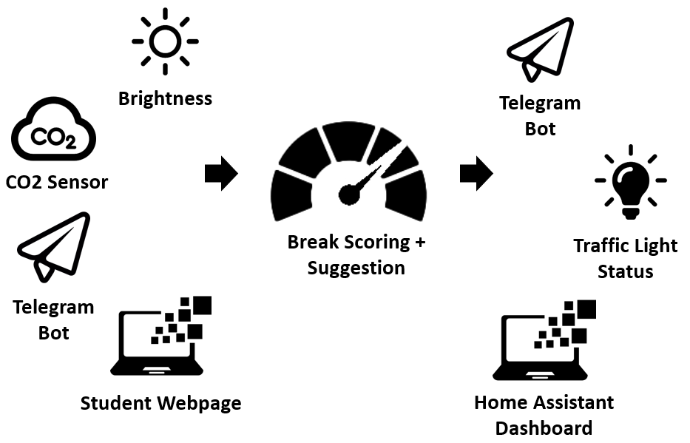
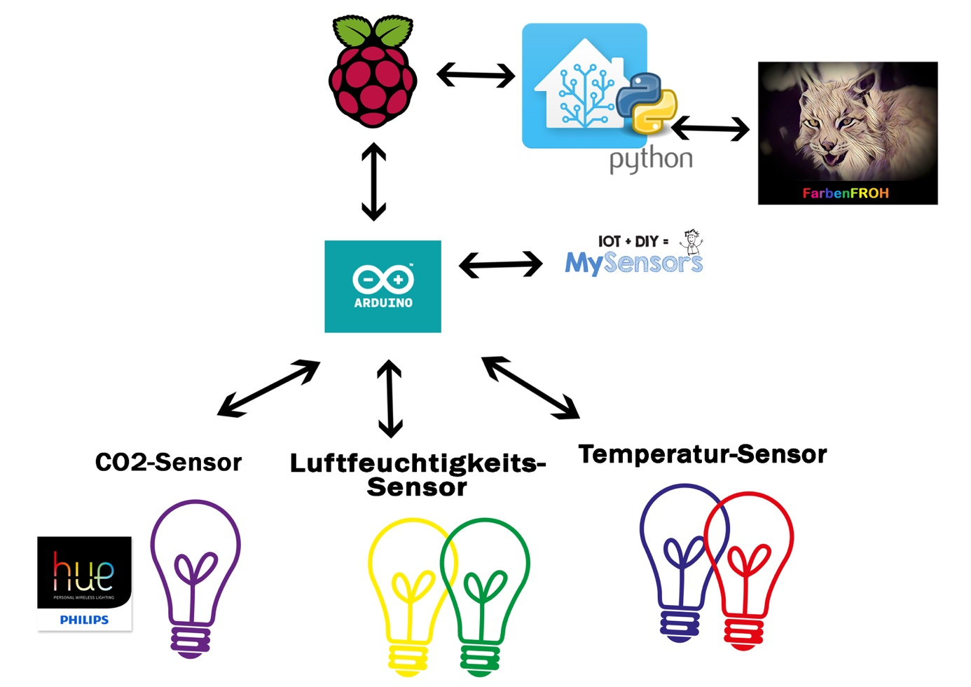
Hackathon Project Integration
Two projects originating in this year‘s IoT Hackathon are being merged
StayFocussed FarbenFROH

Slide 23
Home Assistant Dashboard

Slide 24
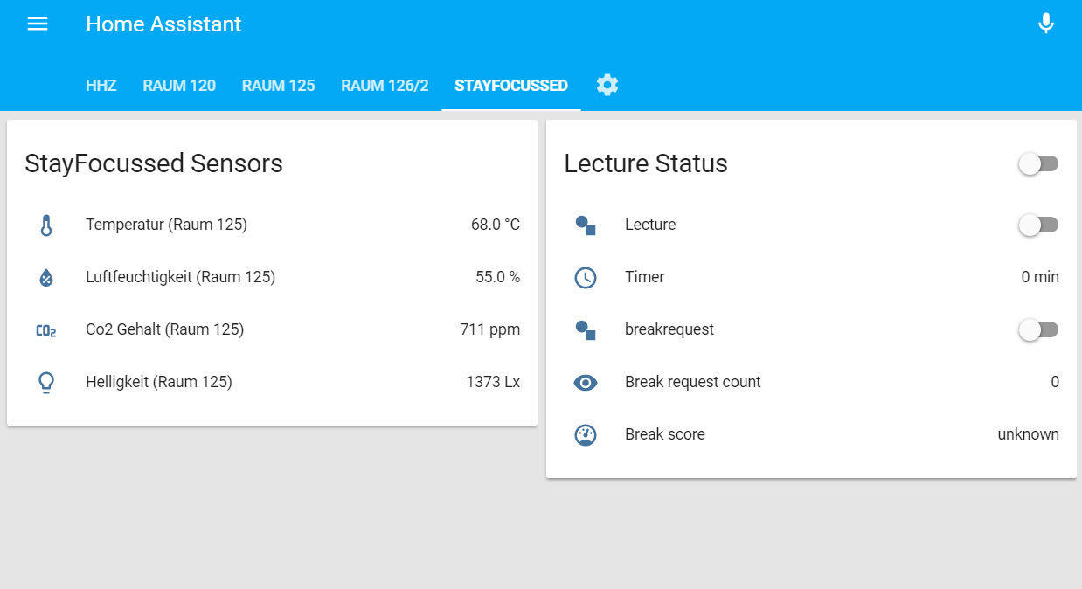
Home Assistant Dashboard

Slide 25
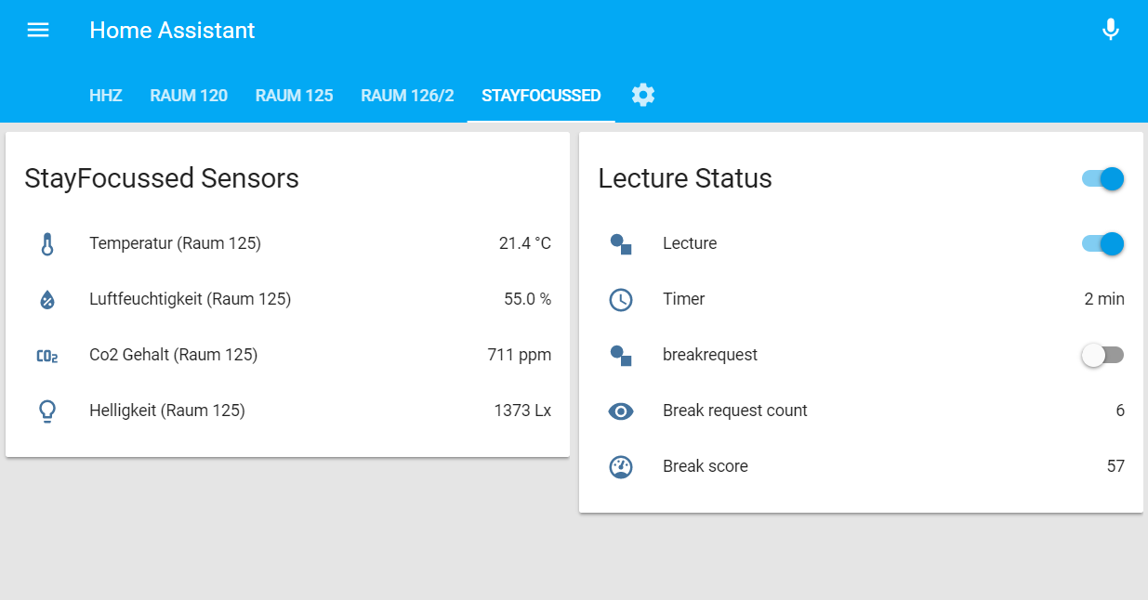
Home Assistant Dashboard

Slide 26
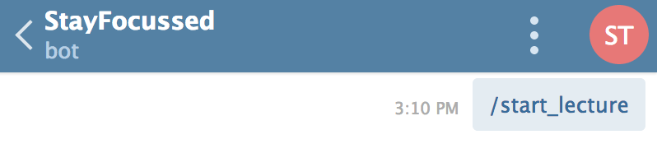
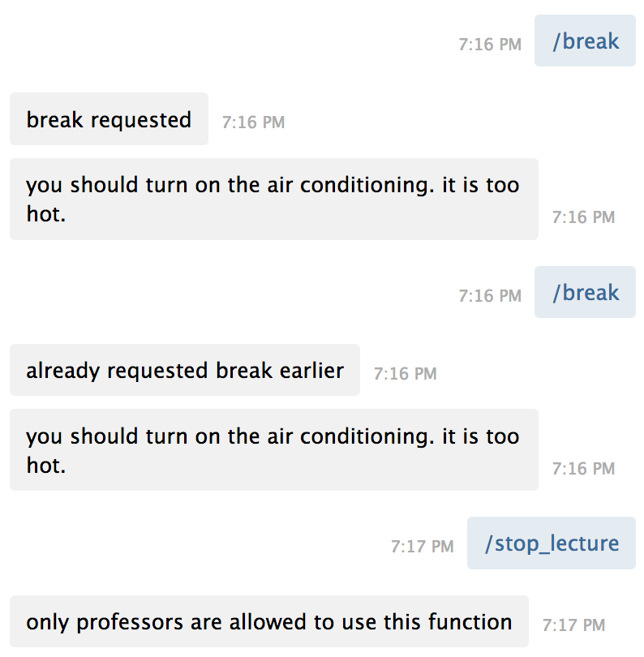
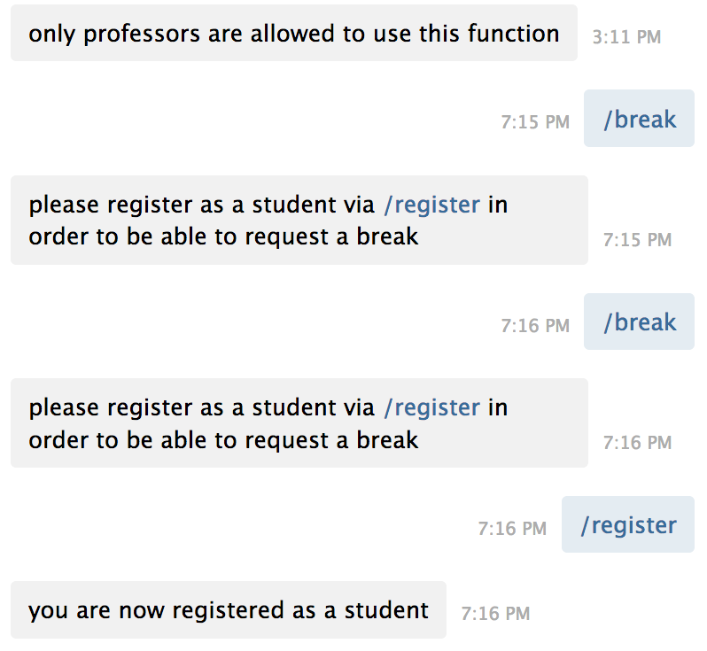

Telegram Bot

Slide 27
Outlook

Slide 28
Outlook: Project Part 2
What are we going to do?
Conceptual app design
Central touchpoint (infos, functionalities,..)
Integration of various HHZ projects
Authentication as student/professor
Survey: Which features should the app have?
Choice of app framework
Application programming
Notes:
Was machen wir?
App-Konzeption
Zentraler Anlaufpunkt (Infos, Funktionalitäten,..)
Integration von HHZ-Projekten
Authentifizierung als Student/Professor
Umfrage: Was soll die App können?
Auswahl des App-Frameworks?
Programmierung der App

Slide 29
Outlook: Project Part 2
Which further ideas do we have?
Home Connect interface
Integrate the smart home objects currently in our innovation room
Smart Contracts
Tamper-proof implementation of automatic contracts via blockchain
Notes:
Home-Connect-Schnittstelle (Smart Home Geräte aus dem Innovationsraum anbinden)
Smart Contracts
Are solved automatically and do not need human intervention
Also the contract maintenance is automated in the system
For implementation a blockchain is used and acts like a decentralized database in the system
The blockchain is considered as tamper-proof

Slide 30

Q & A

